Slide 1

CALL FORWARDING SYSTEM SIMULATOR IMPLEMENTATION

Slide 2
TEAM MEMBERS
Sudha Singh (TL)
Kirti Singh
Shikha Mishra
Komal Matsagar
Jayashree Mishra
Rutuja Navghare

Slide 3
ABOUT THE PROJECT
The objective of the project is limited to build a call forwarding simulator application which consists of configurable database and user application. That application provides call forwarding services to user. It validates a user request if requested user has enabled call forwarding service, then it establishes connection between the requesting user and intended forwarding user. Otherwise it establishes connections between the requesting user and requested user. User can enable or disable the services at run time.

Slide 4
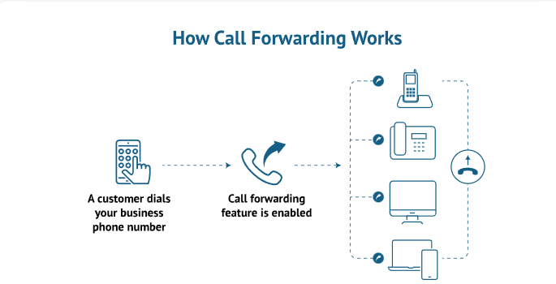
HOW CALL FORWARDING WORKS???

Slide 5

INTRODUCTION
Call forwarding is a telephony feature of all telephone switching systems which redirects a telephone call to another destination which may be for example a mobile or another telephone number where the desired called party is available. It is commonly used to forward calls to an office phone to a user's cell or home phone or a colleague's number.

Slide 6




MAJOR SYSTEM REQUIREMENTS
C PROGRAMMING
LINUX
FILE HANDLING
UBUNTU

Slide 7
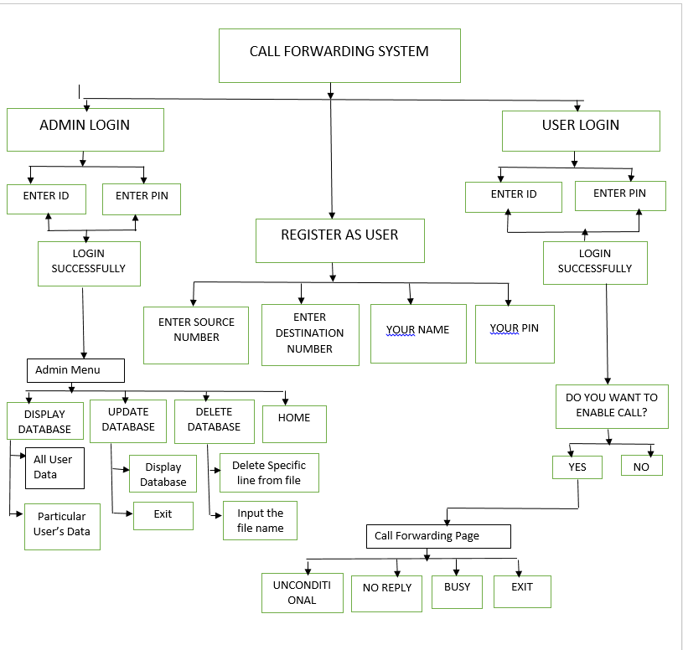

Slide 8
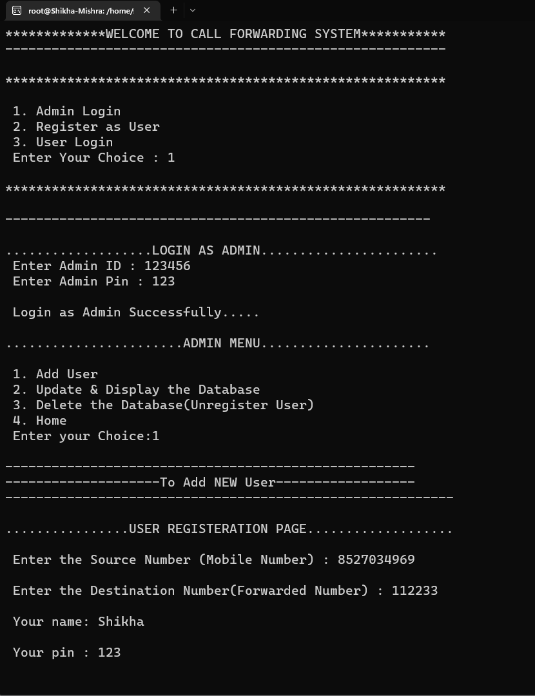
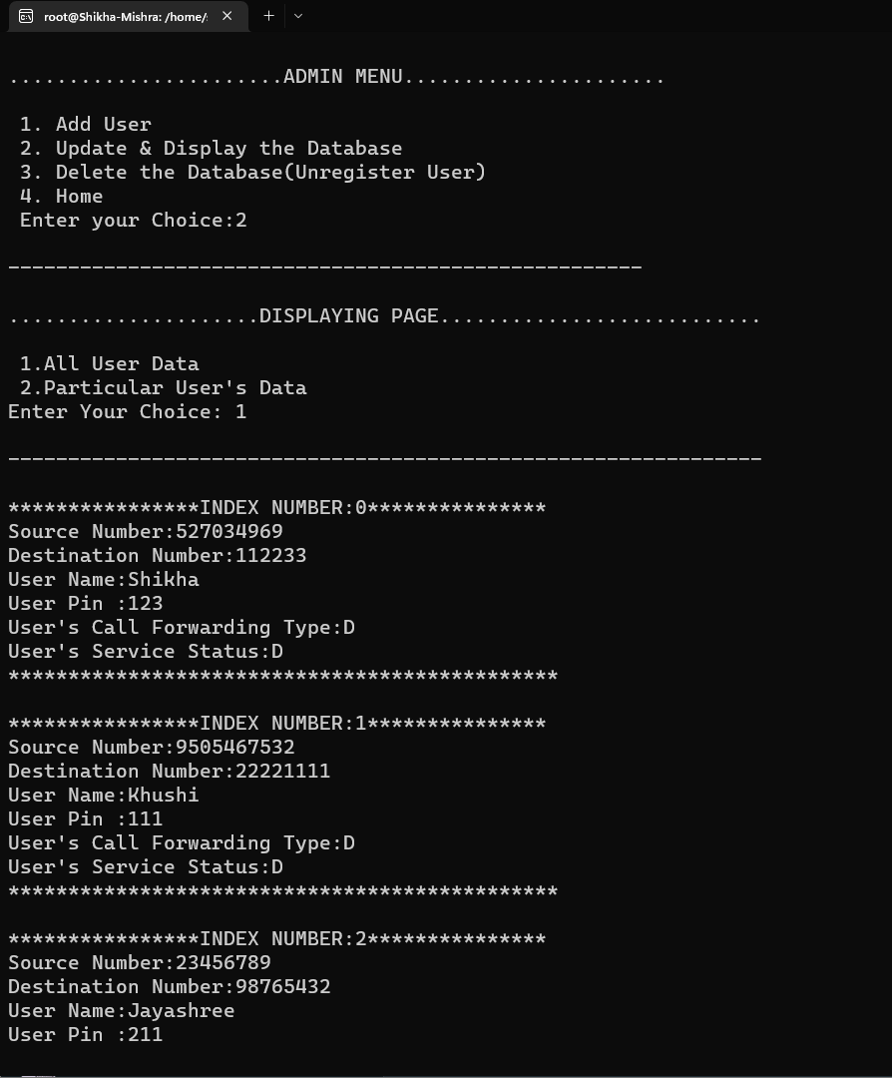
Admin maintains a database for the call forwarding details.

Slide 9
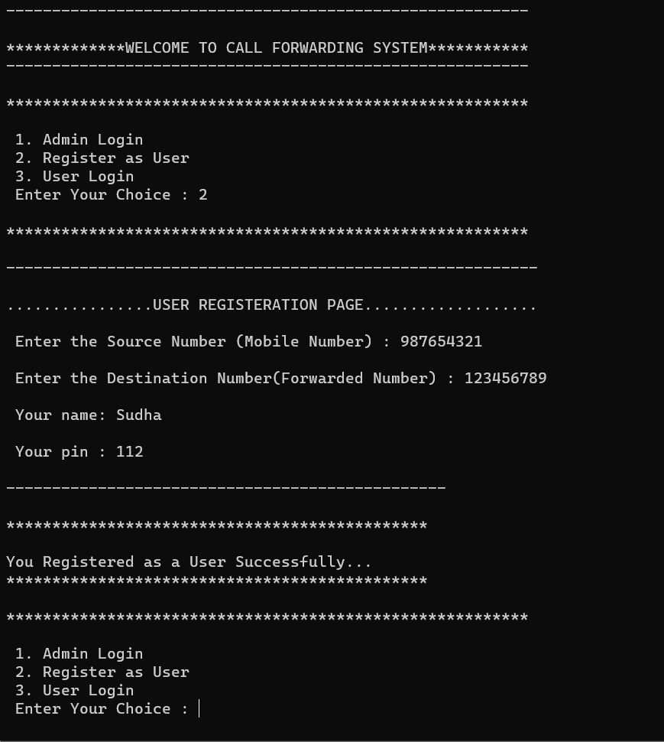
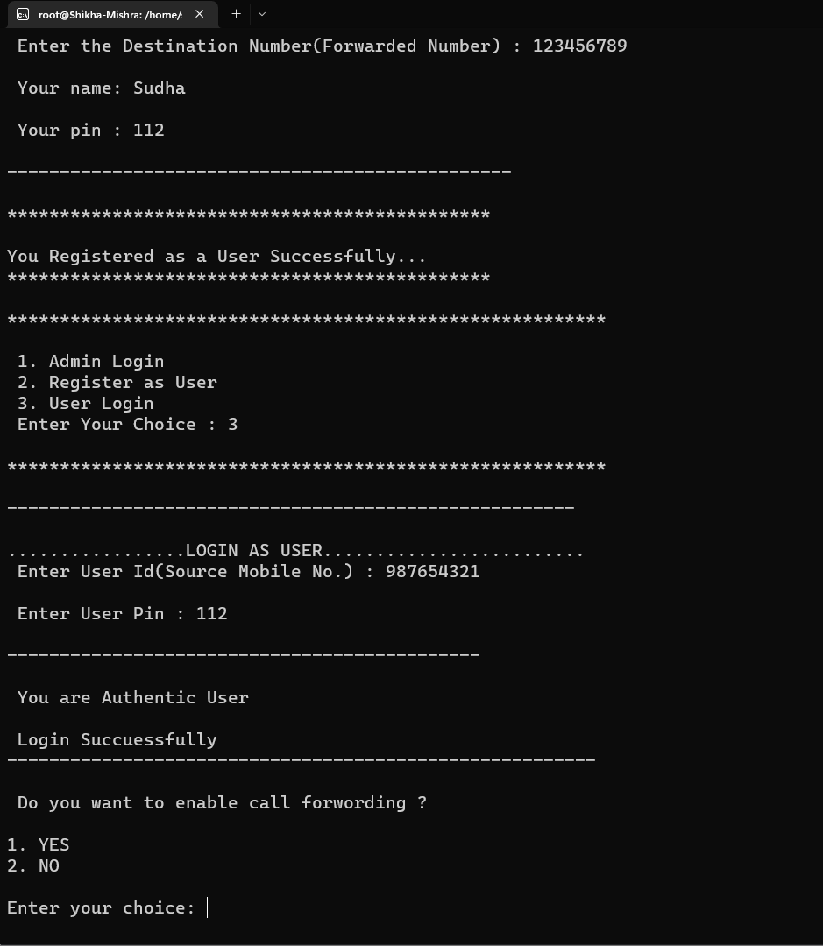
User register with application to request for call forwarding service
Registered users to activate or deactivate the service as per their requirement.
Three types of call forwarding.

Slide 10
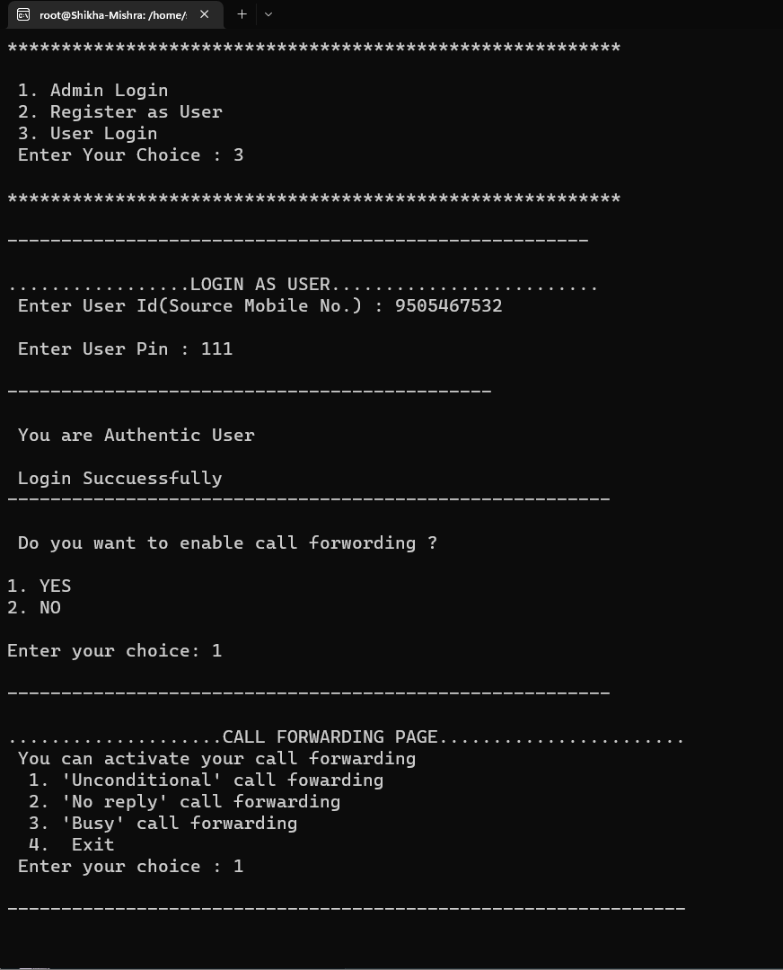
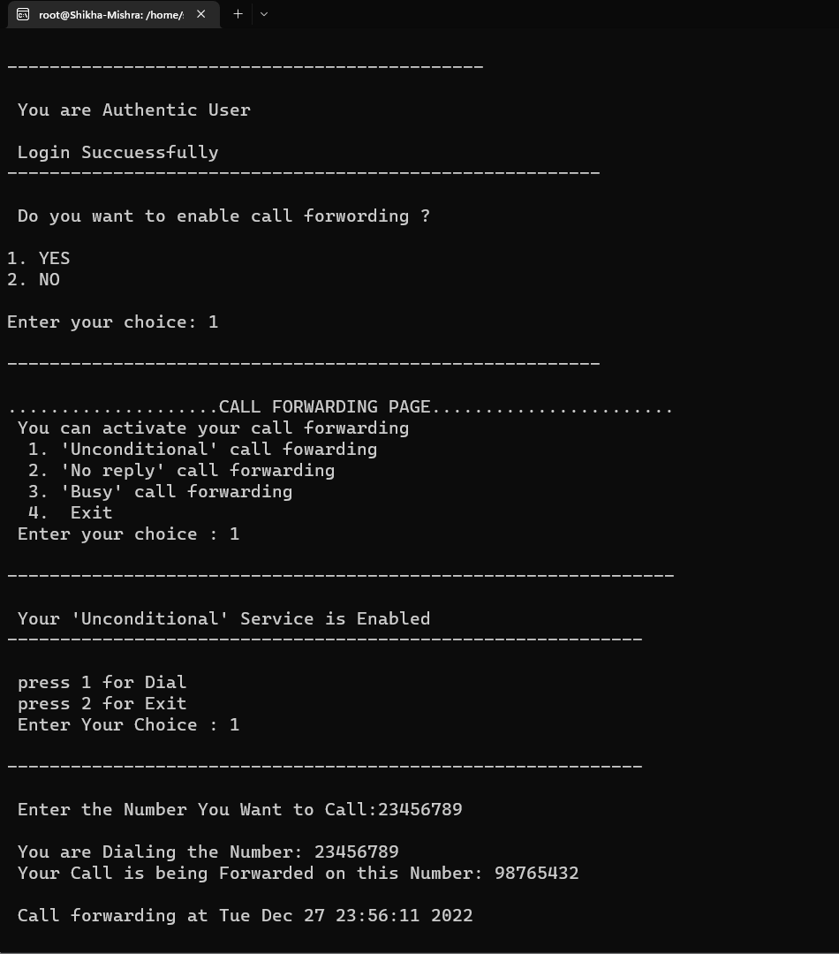
Registered and Authenticated User can enable or disable the Call forwarding service anytime.
It will check for activation of forwarding service using its database and if service is activated, then forward accordingly depending on the call forwarding type with date timestamp.

Slide 11
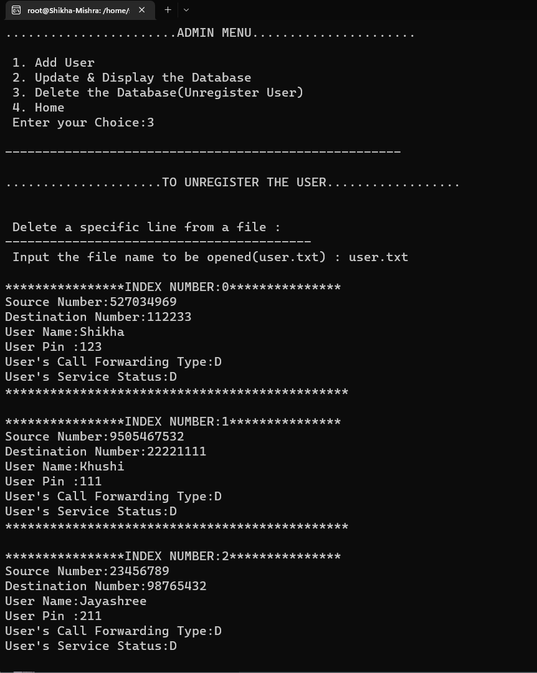
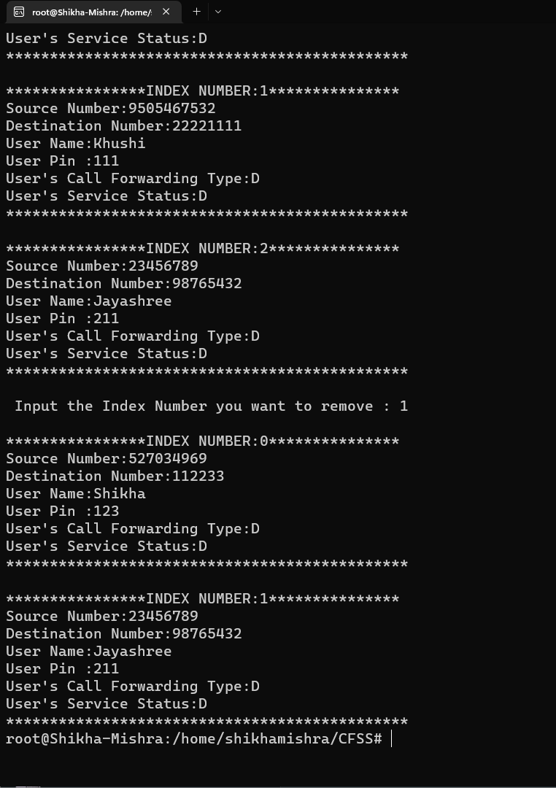
Admin shall allow delete and update the database entries.

Slide 12
BENEFITS OF CALL FORWARDING
Better customer service.
Save money with call forwarding.
Never miss important call.

Slide 13
ADVANTAGES
Divert calls to anywhere in the world.
Integrating call forwarding with your existing systems.
Easy installation and Business scaling.
Call forwarding saves money.
DISADVANTAGES
Main phone lines are often shared in an office but call forwarding can prevent sharing the load and can add extreme pressure to the person taking calls.
Higher team mobile costs due to remote working.
Losing internal phone transferring means your team are regularly having to take and forward messages adding extra work for them and increasing customer response times.

Slide 14
THANK YOU !!!

